Slide 1


ns-3
Dr. Rajiv Misra
Associate Professor
Dept. of Computer Science & Engg.
Indian Institute of Technology Patna
rajivm@iitp.ac.in
ns-3

Slide 2
NS3 – NETWORK SIMULATOR 3.30
The ns-3 simulator is a discrete-event network in which the simulation core and models are implemented in C++ and simulator targeted primarily for research and educational use.

Slide 3
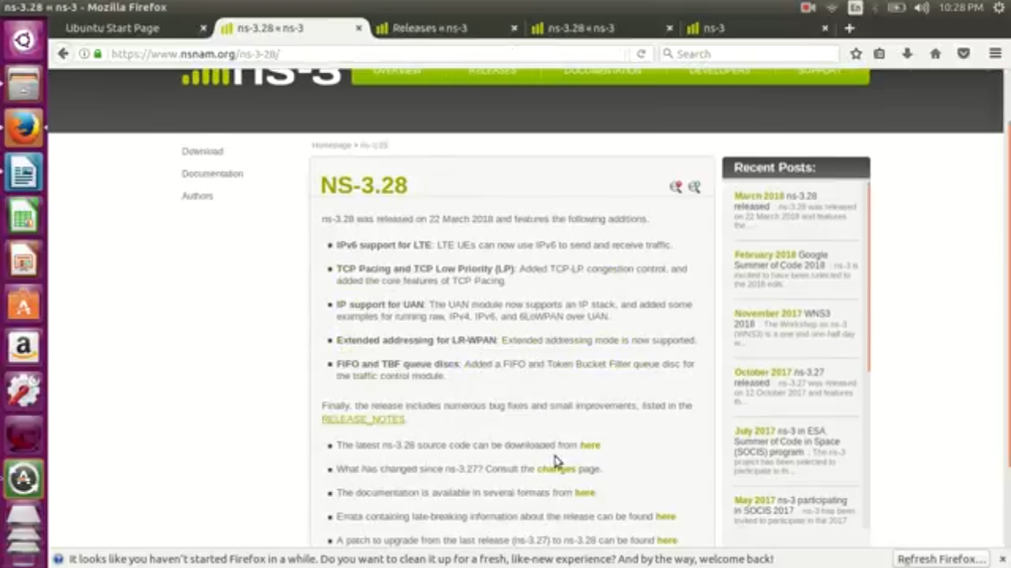
INSTALLATION OF NS-3
Step 1 – Download source file from official site

Slide 4
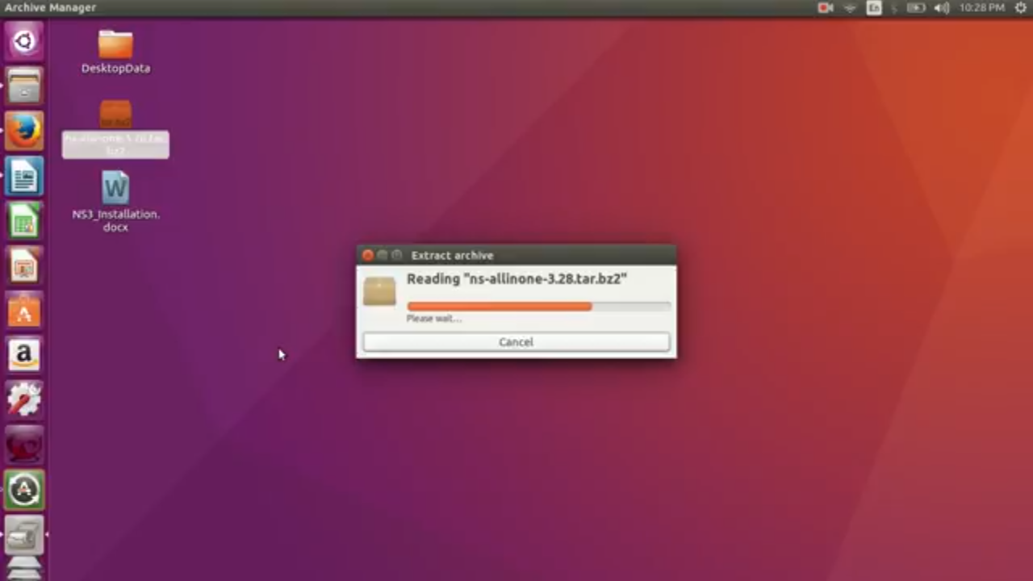
Installation Procedure
Step 2 – extract tar file

Slide 5
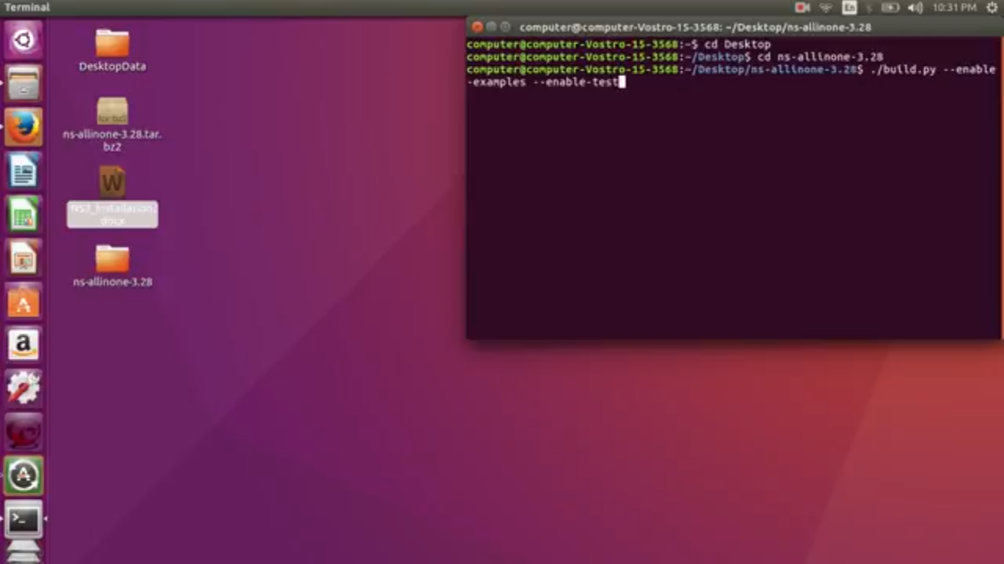
Step 3 - go to nsallinone 3.28 folder and build the files by
./build.py --enable-examples --enables-test

Slide 6
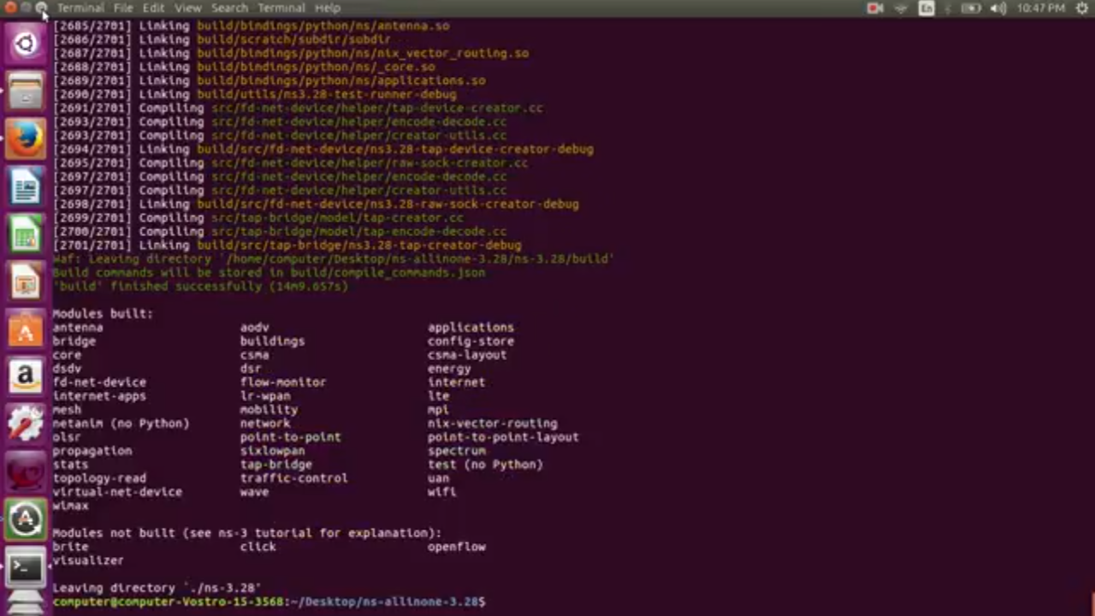
Output : if this shows then our file is built successfully.

Slide 7
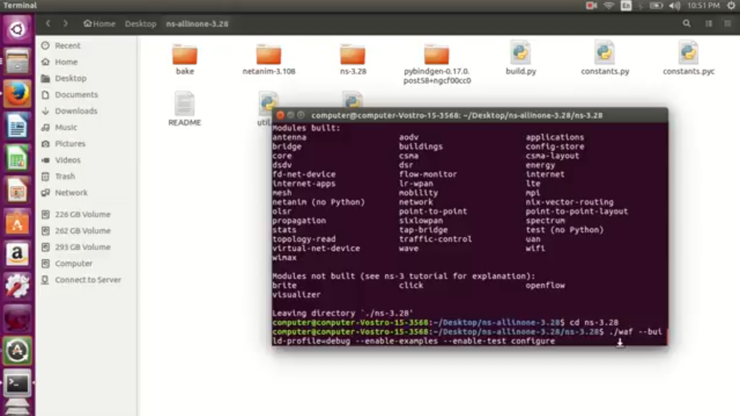
Step 4 -debug the build .inside ns-3.28 folder use “./waf --build-profile=debug --enable-examples --enable-test configure”

Slide 8
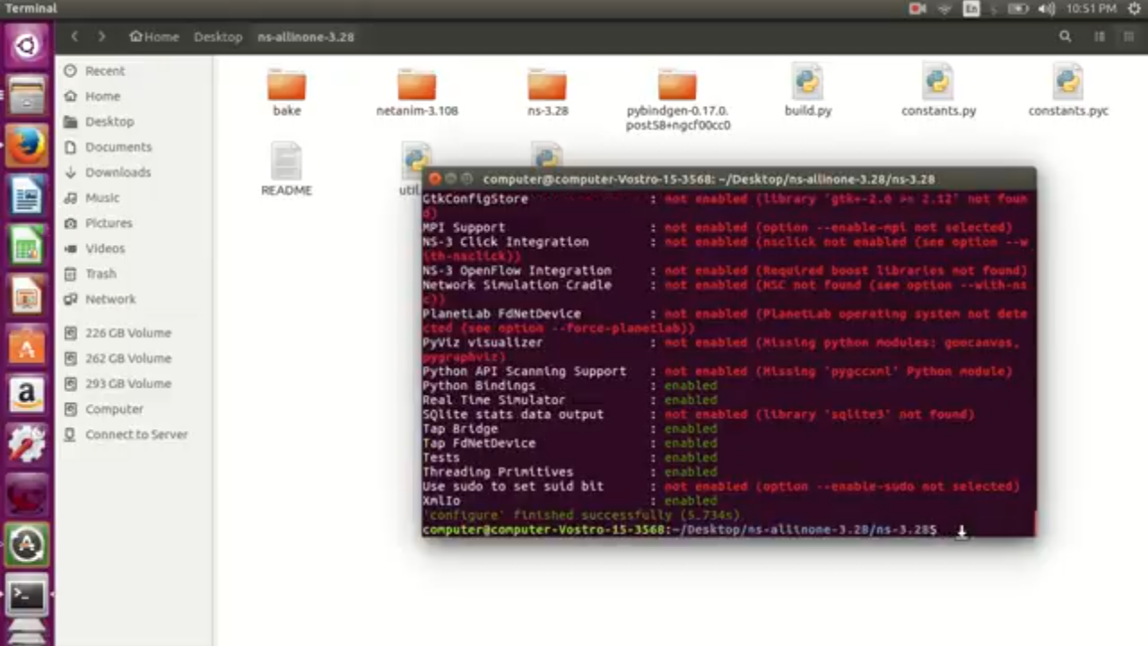
output

Slide 9
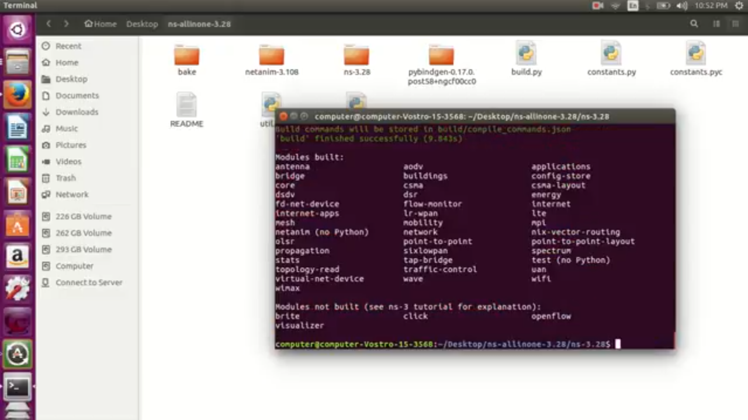
Step 5 – build the debug version by “./waf ” . it will give following output .

Slide 10
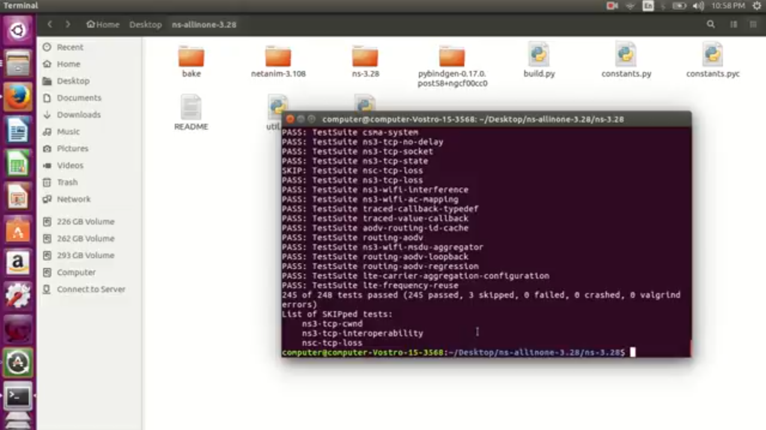
Step 6-run the test file . By using “./test.py”

Slide 11
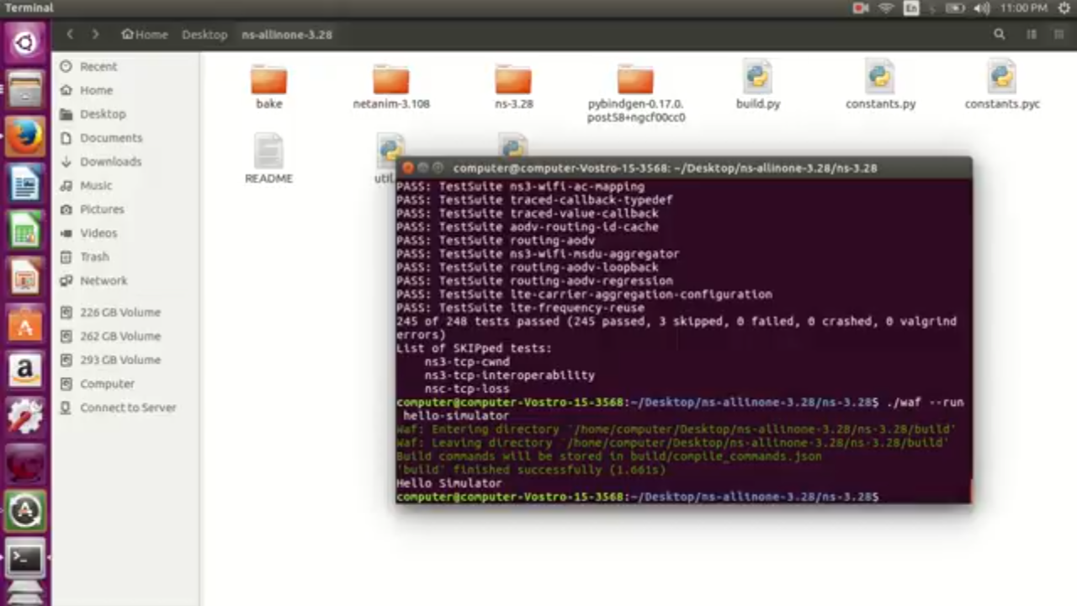
Step 7 -run one file to check installation. Use “./waf --run hello-simulator” to run hello simulator file

Slide 12
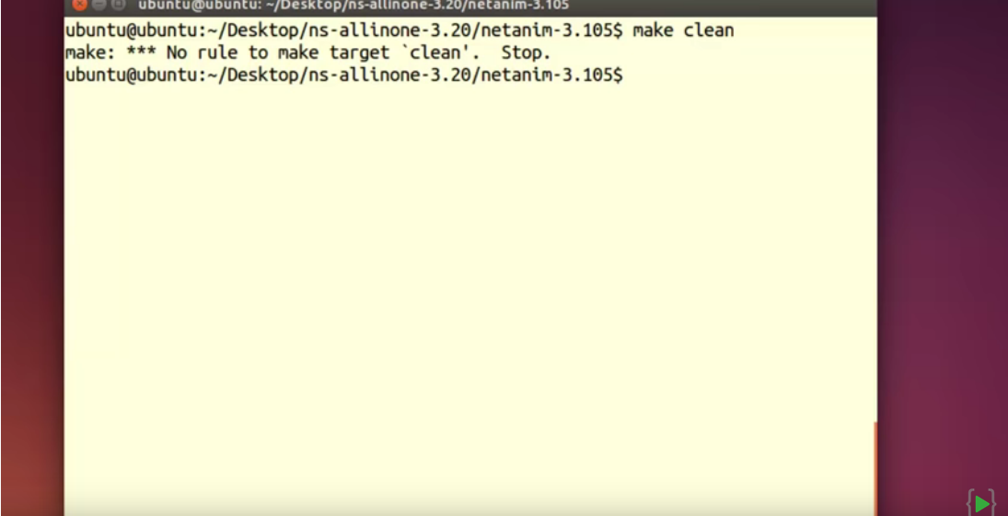
Install NetAnim
Step 1 -inside netanim-3.108 folder use command “make clean”. It will remove the program binaries and object files from the source code directory .

Slide 13
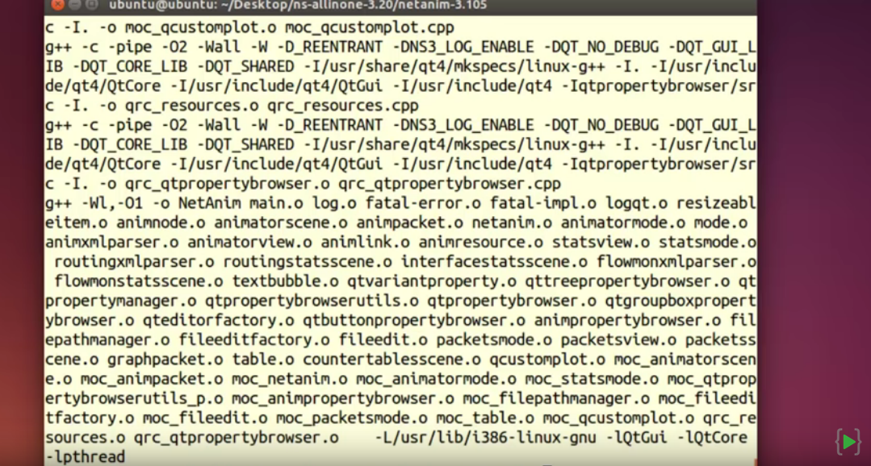
Step 2 – now use command “qmake netanim.pro” and then use “make”. It will give output like this.

Slide 14
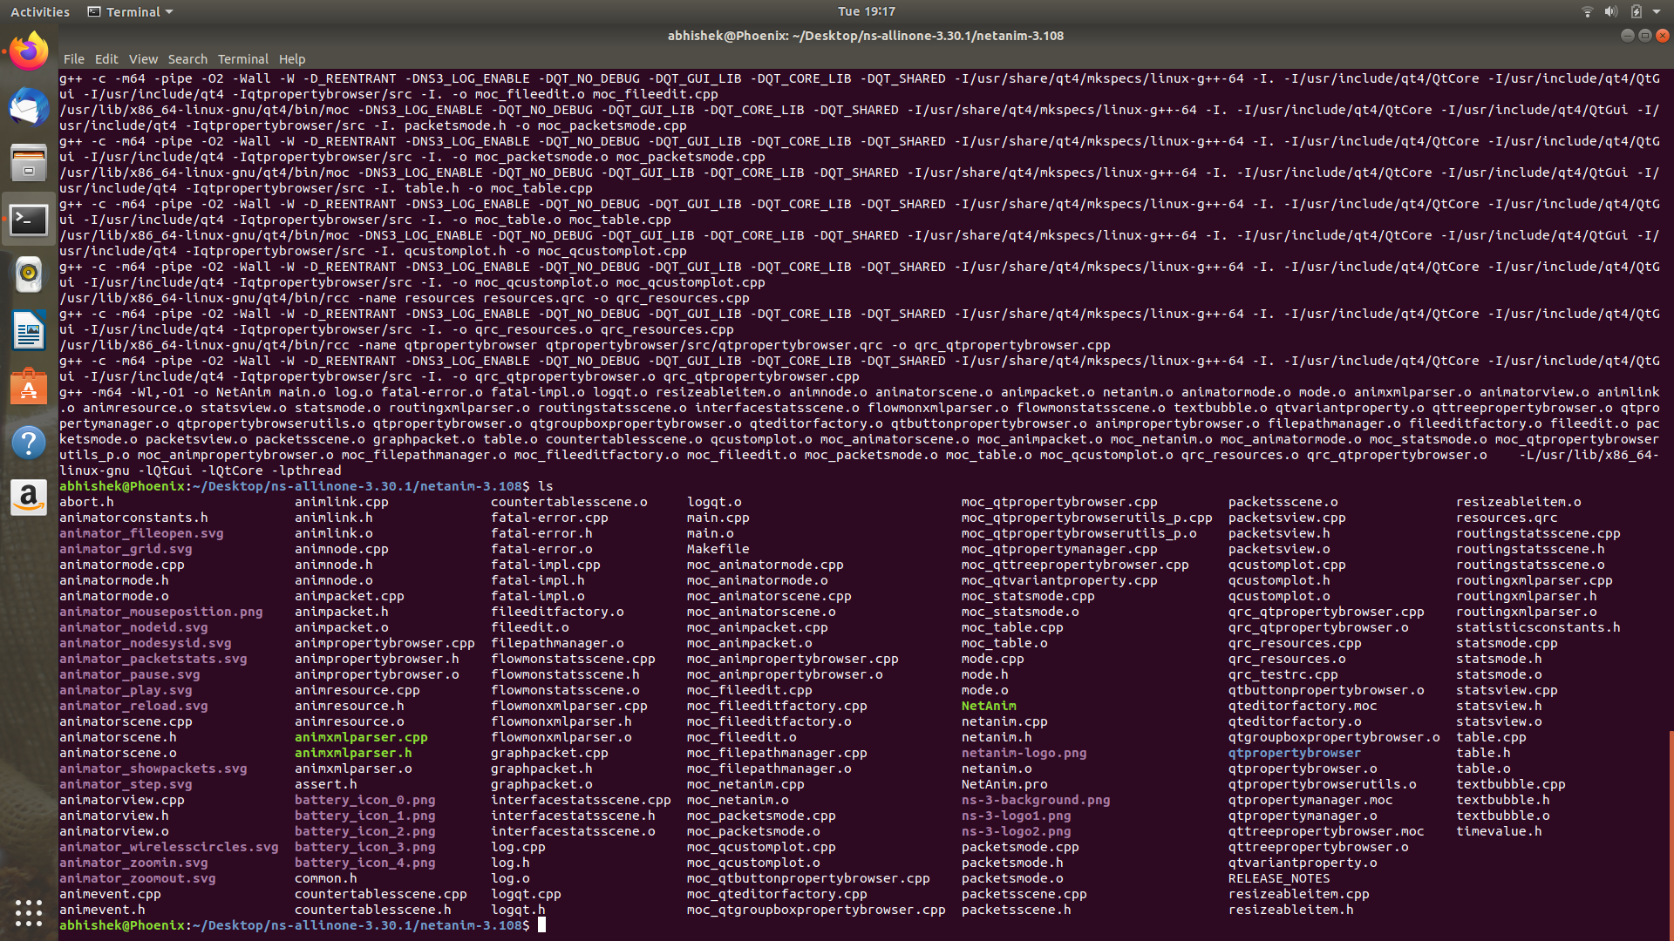
Step 3 – above commands will make netanim ready to use. Use “ls” command to see “NetAnim”.
file .

Slide 15
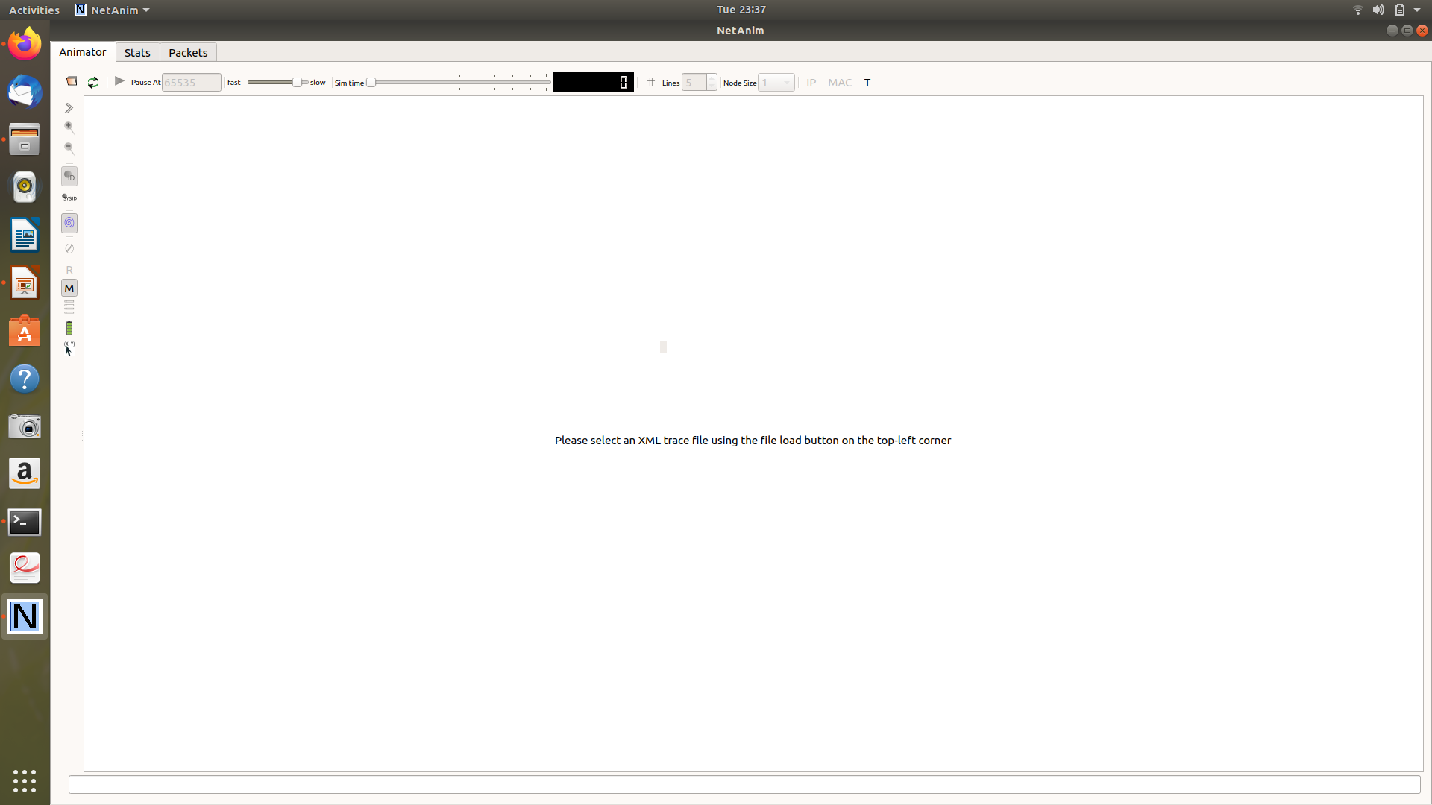
Step 4 – use “./NetAnim” command to run netanim. It will open a window like this. Choose xml file to run visualisation.

